Slide 1

M.S. ADS Final Portfolio
IST 782 - Syracuse University ISchool, 2023
https://github.com/jrmaugeri/MS-ADS_Portfolio/tree/main
Joseph Richard Maugeri IV_____________________________________
Notes:
Welcome to Joseph Maugeri’s Final Portfolio Presentation. It is June 9th , 2023, at the time of this recording. All material presented and discussed is available through the link to the github repository pictured on screen. This was completed through IST 782, the applied data science portfolio as my final degree requirement.

Slide 2
Introduction
A strong curiosity and continuously bringing individuality have been my greatest asset in undertaking the curriculum. I choose mostly scientific applications, due to my goals of enhancing analytical techniques and access of subject-matter experts to those techniques. Its critical to consider real-world relationships influenced by human behavior in many cases, and I’ve expanded on my professional skills and aimed my methods at my S.T.E.M. interests. Which better prepares me for a career in computer science research aspiring to benefit researchers at a whole. The importance of answering the growing pool of business questions, so that true prescriptive analytics can be performed. Shedding light on subject matter experts and assisting to communicate their work to a larger audience through technological and analytical services. There will never not be a need for unique and human input to the data science process, for which effective knowledge sharing is at the core of the input process. With that comes the importance of asking questions, collaboration and building relationships all to inspire creativity in data science. Ultimately, my project selection showcases these truths in applied data science and my passion for expanding the access to valid knowledge overall.
Joseph R Maugeri IV - IST 782 - Syracuse University ISchool, 2023
Notes:
Introduction slide, contextualize your overall purpose and aim of pursuing the ADS program

Slide 3
Collect, store, and access data by identifying and leveraging applicable technologies
IST 615 Cloud Management Final Project Any enterprise has unique needs for developing their own data culture, sometimes a Cloud solution is a big part of that. Choosing a solutions rely on strategies developed for their use cases, from informed positions. Governing policies are important for standardizing interactions and responsibilities related to data. My employer's cloud migration strategy will follow a similar path as this project’s. Specific recommendations were justified for SAP ERP business warehouse to SAP S/4 HANA cloud platform. Addresses operational inefficiencies, data availability issues, and increasing hosting costs. Additionally, data consolidation, AI augmentations, machine learning, and robotic process automation can be applied more effectively to improve performance and real-time solutions. Choosing SAP S/4 HANA Cloud had advantages due to the existing relationship between SAP and the Employer, as well as SAP’s commitment to optimizing their services and products for the cloud. hybrid cloud model for future expansion and integration of additional resources. Keeping our technology competitive provides additional value-added solutions to our practice. The project showcased my understanding of system capabilities and the ability to provide recommendations for weaknesses in operational management.
Joseph R Maugeri IV - IST 782 - Syracuse University ISchool, 2023
Notes:
The first project we will discuss speaks to a real world business case derived from my current place of employment. For context, (read slide notes)

Slide 4
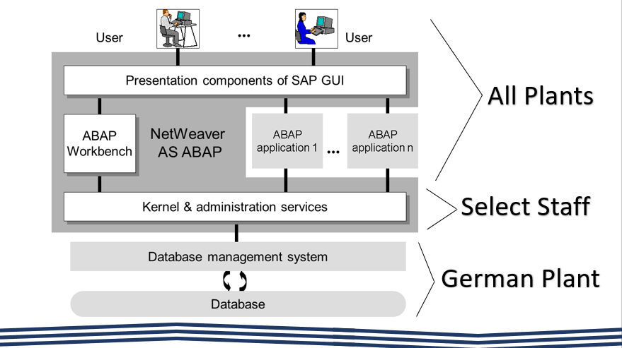
Collect, store, and access data by identifying and leveraging applicable technologies
IST 615 Cloud Management Final Project
Joseph R Maugeri IV - IST 782 - Syracuse University ISchool, 2023
Notes:
This slide is an example of the modeling and discovery performed to document the business case which required a better way to collect, store and access information at the international company. Briefly put, the company hosts it’s own servers, and has rapidly expanded to the point of needing better data access, consistent governing policies, and greater failsafe recovery capabilities.

Slide 5
Create actionable insight across a range of contexts using data and the full data science life cycle
IST 707 Final Project – Mushroom Classification using ML Algorithms We explore the application of data science to the classification of mushrooms into edible and poisonous categories. My personal interest in biology and the desire to apply data science skills to uncover insights in a culturally significant topic. Highlight the historical and cultural significance of mushrooms, emphasizing the importance of preserving human knowledge and the connection between humans and ecosystems. Dataset: The “mushroom” dataset containing information on 23 species and a class of edibility, obtained from the National Audubon Society Field Guide to North American Mushrooms. Analysis Techniques: Explore various classification and data mining techniques, including K-means and hierarchical clustering, association rule mining, and decision tree algorithms. Results: K-means and hierarchical clustering were not suitable for the dataset due to overlapping features and variations within species. Decision tree and random forest algorithms were more effective in classification. Present visual representations of clustering results, association rules, decision trees, and accuracy metrics through confusion matrices. Insights: Iterative testing is critical during model selection in classification problems, meaning no one-size-fits-all. Conclusion: Draw lines between the cultural significance of mushrooms and reasons to use these techniques with them.
Joseph R Maugeri IV - IST 782 - Syracuse University ISchool, 2023
Notes:
The mushroom dataset was one of my favorite projects to work on. In this (read slide). Please review the detailed presentation included in the github repository, as it expands deeply on the historical and cultural significance of mushrooms with respect to humankind.

Slide 6
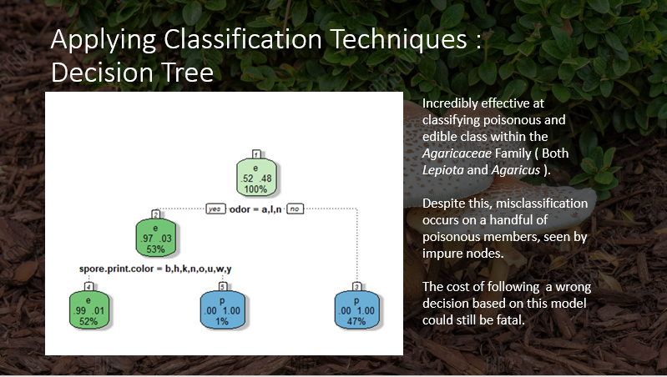
Create actionable insight across a range of contexts using data and the full data science life cycle
IST 707 Final Project – Mushroom Classification using ML Algorithms
Joseph R Maugeri IV - IST 782 - Syracuse University ISchool, 2023

Slide 7
Apply visualization and predictive models to help generate actionable insight
IST 707 Homework 5 – Time Traveler Seeks Madison This paper presents a fictional scenario where myself as a time traveler from an alternate timeline, brings data science to try to resolve the mystery of Federalist papers' authorship. By immortalizing Alexander Hamilton's work this resolves the authorship dispute leading to save the United States. Natural language processing techniques are applied to parse and quantify the writing styles of the Federalist papers. Decision Trees: Decision tree models are used to predict authorship based on known authored data. The model is then applied to the disputed papers, but the results are inconclusive. The simplicity of the dataset and over-reliance on specific elements, such as the word "Alexander," led to misleading outcomes. The model's high accuracy raises concerns about the significance of word usage as the sole determining factor. Imbalance in Authors: The dominance of Hamilton's contribution and the removal of co-authored papers may have biased the results, favored Hamilton and compromised the complexity of the dataset. Through this a resolution to time travel to collect or preserve more samples would expand the dataset and may improve the model's accuracy. If a model's results are limited by data or special circumstances, it may be necessary to gather more data to improve and apply the model effectively.
Joseph R Maugeri IV - IST 782 - Syracuse University ISchool, 2023
Notes:
A personal Favorite, (read slide) nevertheless we me the requirements by performing the decision tree task and assessed the reliability of the model for this specific use case.

Slide 8
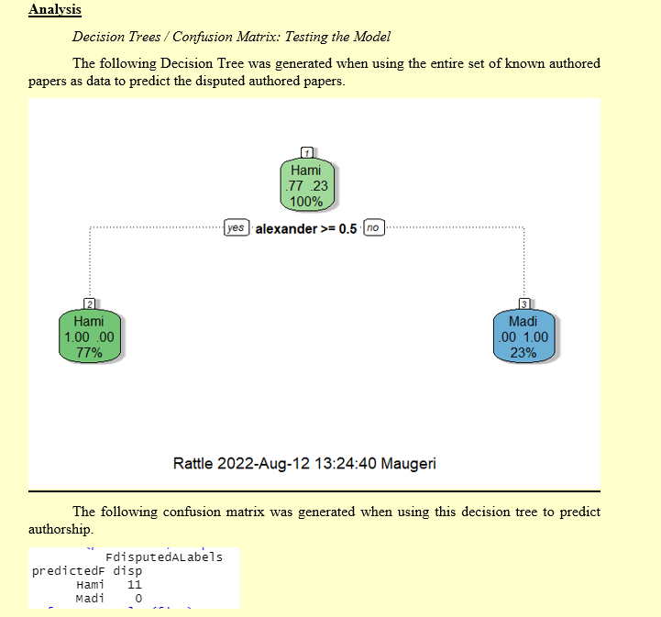
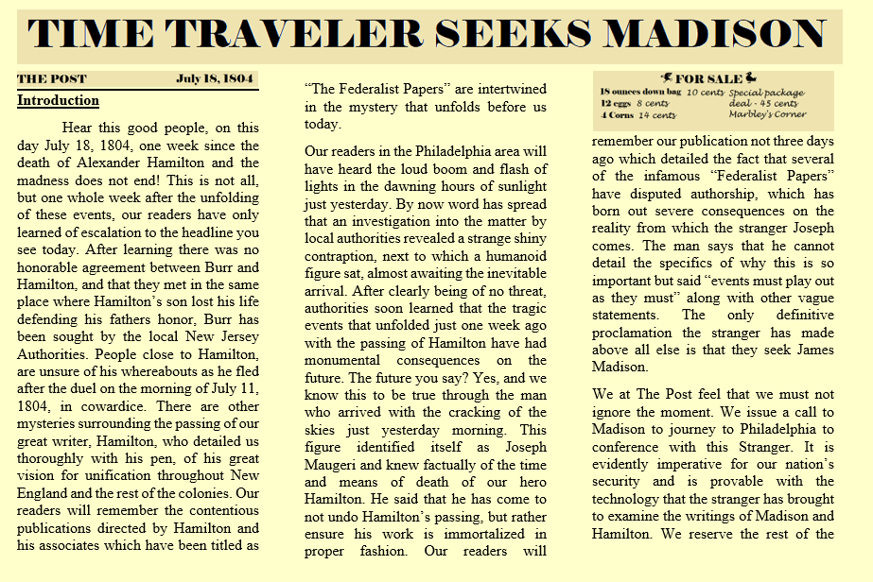
Apply visualization and predictive models to help generate actionable insight
IST 707 Homework 5 – Time Traveler Seeks Madison
Joseph R Maugeri IV - IST 782 - Syracuse University ISchool, 2023
Notes:
The left picture is part of the report in the submitted stylizations I chose for the project. To the right the decision tree algoritihm ( which likely wouldn’t have made sense to early americans, but was publicized in the fictional paper from 1804 nonetheless.

Slide 9
Use programming languages such as R and Python to support the generation of actionable insight
IST 652 Final Project – Associating Elon Musk’s Tweets with Crypto Prices This project aimed to explore the relationship between Elon Musk's Twitter activities and specific word choices he used, compared to the price indexes of cryptocurrencies and fiat currencies. Data Collection: Twitter data of user @ElonMusk was accessed using the TwitterScraper from snscrape. All tweets from 2020 and 2021 were extracted and tokenized to investigate references to cryptocurrencies like ETH, BTC, and DOGE. Market indexes for these coins were obtained from Yahoo Finance. Analysis Approach: The project sought to determine if Musk's tweets about cryptocurrencies influenced their volatility or price movements. However, no significant relationships or associations were found between Musk's tweets and market data. Results: Musk's most frequently used tokens revealed that he discussed various topics, including Tesla, SpaceX, and memes, which made analysis challenging. DOGE was mentioned 50 times, while Bitcoin was mentioned 27 times during the analyzed period. Conclusion: The project concluded that there was no apparent relationship between Musk's tweets and cryptocurrency market data. Further analysis and a more complicated model would be required to investigate this topic thoroughly. It highlighted the importance of learning from initial attempts and using them to enhance future analyses. Insights: The study revealed that Musk's Twitter activities were like those of an ordinary user, with a mix of memes, self-promotion, and varied topics. His tweets did not consistently convey a clear message on specific subjects.
Joseph R Maugeri IV - IST 782 - Syracuse University ISchool, 2023

Slide 10
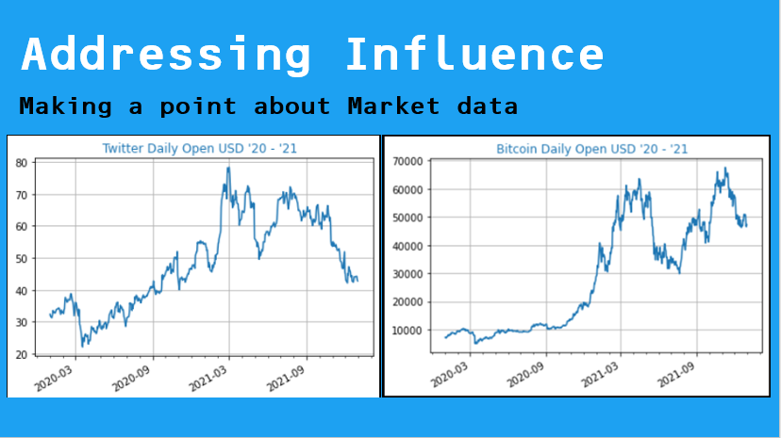
Use programming languages such as R and Python to support the generation of actionable insight
IST 652 Final Project – Associating Elon Musk’s Tweets with Crypto Prices
Joseph R Maugeri IV - IST 782 - Syracuse University ISchool, 2023

Slide 11
Communicate insights gained via visualization and analytics to a broad range of audiences
IST 719 Information Visualization Final Project – Top 20 Hazardous Spills in New York This project focused on using NY’s open data on hazardous material spills to generate time series analyses Using R and several packages such as seaborn, dplyr, plotrix, ggplot and lattice, we present critical information on hazardous liquid spills. Date columns were transformed, and calculations were performed to determine the time taken to contain spills. Unnecessary information was omitted from the final poster to highlight key insights and avoid distracting viewers. The centerpiece of the poster was a large heatmap of NY state showing the quantity of material spilled, highlighting outliers. Separate data frames were created for spills measured in gallons, pounds, and those with missing units. Various visualizations, such as scatter plots, box plots, line plots, and bar charts, were included on the poster to provide a comprehensive understanding of the data. The generated graphics helped identify distribution, trends, outliers, and patterns in the hazardous spill dataset. The information presented in the context of separating outliers and proper resource allocation aimed to inform stakeholders about prevention, recovery, and maintenance strategies.
Joseph R Maugeri IV - IST 782 - Syracuse University ISchool, 2023

Slide 12
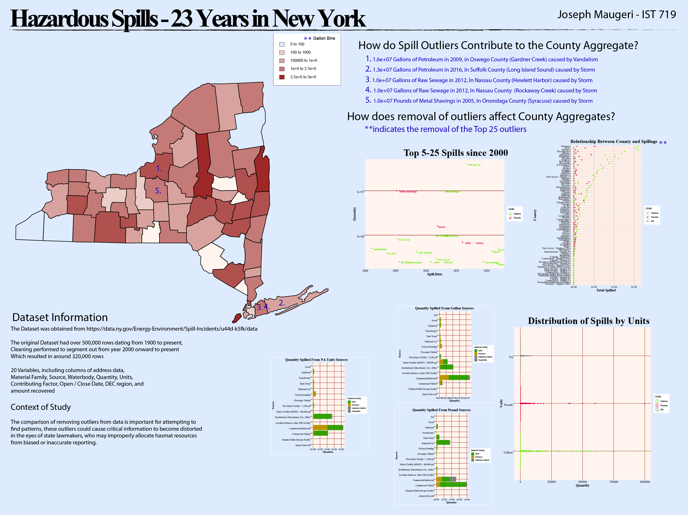
Communicate insights gained via visualization and analytics to a broad range of audiences
IST 719 Information Visualization Final Project – Top 20 Hazardous Spills in New York
Joseph R Maugeri IV - IST 782 - Syracuse University ISchool, 2023

Slide 13
Apply ethics in the development, use and evaluation of data and predictive models
IST 623 Information Security Final Project This project was a deep dive on the history of a social networking platform “Roblox” and investigated their ethics and practices in the context of Information Security. What was found was shocking, and resulted in a call to action to Roblox to modify their services in order to protect our children better, as the internet becomes an increasingly integrated part of their upbringing. What was found on Roblox can be summarize in the following statements: 1.Inconsistent execution of security policies and procedures across different parts of the user base through third-party security vendors, ultimately putting the end user’s information at risk. 2.Unregulated behavior/content and injection of malicious content by users and/or bots targeting/affecting users under the age of 13. 3.Exposing young children to the risks of gambling via encouraging purchase of limited items that fluctuate in value on a global market, without providing guiderails to prevent loss or theft of those items. 4.Profiteering off content creators by compensating labor via in-game currency and penalizing the trade to fiat currency, as well as encouraging microtransactions in an unregulated environment. 5.Providing an unregulated gateway to access off-site via shared links, content-creators websites. 6.Lack of action / delayed action to address child exploitation on the platform.
Joseph R Maugeri IV - IST 782 - Syracuse University ISchool, 2023

Slide 14
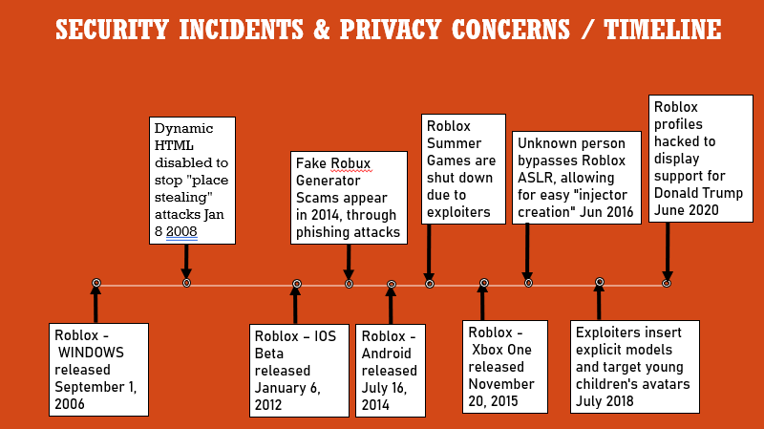
Apply ethics in the development, use and evaluation of data and predictive models
IST 623 Information Security Final Project
Joseph R Maugeri IV - IST 782 - Syracuse University ISchool, 2023

Slide 15
Conclusion
You will have seen by now my proficiency and experience through the various projects in different domains and subjects, involving extensive research, data analysis, and application of analytical techniques. This includes natural language processing, machine learning, social media, technology, and ethics-based decision making. Highlighted drawing meaningful conclusions and provided recommendations based on the findings. Utilized fundamental analysis programming languages, particularly Python, R, SQL throughout the program Adapted research methodologies to suit project objectives and challenges, and then committing to leveraging data for informed decision-making. Contributing to the advancement of knowledge and best practices in various fields. Importance of Collaboration and Ethical Considerations: Projects were not done alone; collaboration and teamwork were crucial. All in all, this selection of projects demonstrates the key aspects required of the MS ADS curriculum and communicate my style of data science clearly. With that I leave you with one of my favorite quotes that speaks to the heart of my style. “It is the mark of an educated mind to entertain a thought, without accepting it” -Aristotle
Joseph R Maugeri IV - IST 782 - Syracuse University ISchool, 2023
Notes:
Introduction slide, contextualize your overall purpose and aim of pursuing the ADS program

Slide 16
The End
Joseph R Maugeri IV - IST 782 - Syracuse University ISchool, 2023
Notes:
Introduction slide, contextualize your overall purpose and aim of pursuing the ADS program

